Slide 1
Software Requirement Engineering
Topic: Functional Requirements
Engr. Sara Rehmat

Slide 2
Different types of requirements
Clear and effective communication is the core principle of requirements development
A skilled business analyst will choose the most effective way to communicate each type of requirements information to each audience.
The vision and scope document contains the business requirements
User requirements can be captured in the form of use cases or user stories.
The product’s functional and nonfunctional requirements often are stored in a software requirements specification, or SRS, which is delivered to those who must design, build, and verify the solution.
Recording requirements in an organized fashion that key project stakeholders can review helps ensure that they know what they’re agreeing to.

Slide 3
Problems with recording SRS in word-processing documents
We will describe the SRS as being a document, but it doesn’t have to be in the form of a traditional word-processing document.
In fact, documents pose numerous limitations:
It’s difficult to store descriptive attributes along with the requirements.
Change management is clumsy.
It’s difficult to retain historical versions of the requirements.
It’s not easy to subset out a portion of requirements that are allocated to a particular iteration or keep track of those that were once approved but then deferred or canceled.
It’s hard to trace requirements to other development artifacts.
Duplicating a requirement that logically fits in multiple places causes maintenance issues.

Slide 4
Requirements Documents
As alternatives, you might store information in a spreadsheet (which has many of the same limitations as a document), a Wiki, a database, or a requirements management (RM).
Think of these as different possible repositories or containers for requirements information.
Not everyone agrees that it’s worth the time to document requirements.
In agile projects we don’t have detailed requirements document.

Slide 5
Requirements in iterations
You will never get perfect requirements. This is why it’s important to have representatives of those audiences review the requirements to make sure they’ll meet their needs.
Progressive refinement of detail is a key principle for effective requirements development.
On most projects it’s neither realistic nor necessary to pin down every requirement detail early in the project. Instead, think in terms of layers.
You need to learn just enough about the requirements to be able to roughly prioritize them and allocate them to forthcoming releases or iterations.
Then you can detail groups of requirements in a just-in-time fashion to give developers enough information so they can avoid excessive and unnecessary rework.

Slide 6
Representation of software requirements
You can represent software requirements in several ways, including:
  Well-structured and carefully written natural language.
  Visual models that illustrate transformational processes, system states and changes between them, data relationships, logic flows, and the like.
  Formal specifications that define requirements by using mathematically precise specification languages.

Slide 7
Software Requirements Specifications
The software requirements is sometimes called a business requirements document (BRD), functional specification, product specification, system specification, or simply requirements document.
But “software requirements specification” is an industry-standard term(ISO/IEC/IEEE 2011).

Slide 8
Audiences of SRS
Numerous audiences rely on the SRS:
Customers, the marketing department, and sales staff need to know what product they can expect to be delivered.
Project managers base their estimates of schedule, effort, and resources on the requirements.
Software development teams need to know what to build.
Testers use it to develop requirements-based tests, test plans, and test procedures.
Maintenance and support staff use it to understand what each part of the product is supposed to do.
Documentation writers base user manuals and help screens on the SRS and the user interface design.
Training personnel use the SRS and user documentation to develop educational materials.
Legal staff ensures that the requirements comply with applicable laws and regulations.
Subcontractors base their work on—and can be legally held to—the specified requirements.

Slide 9
Incremental Development of Requirements
You should capture the requirements for each increment before building that increment.
Incremental development is appropriate when you want to get some functionality into the users’ hands quickly.
Feedback from using the early increments will shape the rest of the project.
However, every project should baseline an agreement for each set of requirements before the team implements them.
Baselining is the process of transitioning an
SRS under development into one that has been reviewed and approved. Working from an agreed-upon set of requirements minimizes miscommunication and unnecessary rework. See

Slide 10
Readability Suggestion
Use an appropriate template to organize all the necessary information.
Label and style sections, subsections, and individual requirements consistently.
Use visual emphasis (bold, underline, italics, color, and fonts) consistently and judiciously. Remember that color highlighting might not be visible to people with color blindness or when printed in grayscale.
Create a table of contents to help readers find the information they need.
Number all figures and tables, give them captions, and refer to them by number.
If you are storing requirements in a document, define your word processor’s cross-reference facility rather than hard-coded page or section numbers to refer to other locations within a document.
If you are using documents, define hyperlinks to let the reader jump to related sections in the SRS or in other files.
If you are storing requirements in a tool, use links to let the reader navigate to related information.
Include visual representations of information when possible to facilitate understanding.
Enlist a skilled editor to make sure the document is coherent and uses a consistent vocabulary and layout.

Slide 11
Labeling requirements
Every requirement needs a unique and persistent identifier.
Labels are used
  to refer to specific requirements in
    a change request,
    modification history,
    cross-reference, or
    requirements traceability matrix.
  to enable reusing the requirements in multiple projects.
  facilitate collaboration between team members when they’re discussing requirements, as in a peer review meeting.
Simple numbered or bulleted lists aren’t adequate for these purposes. Let’s look at the advantages and shortcomings of several requirements-labeling methods. Select whichever technique makes the most sense for your situation.

Slide 12
Labelling Requirements - Sequence number
The simplest approach
gives every requirement a unique sequence number, such as UC-9 or FR-26.
Commercial requirements management tools assign such an identifier when a user adds a new requirement to the tool’s database.
The prefix indicates the requirement type, such as FR for functional requirement.
A number is not reused if a requirement is deleted, so you don’t have to worry about a reader confusing the original FR-26 with a new FR-26.
Drawbacks
This simple numbering approach doesn’t provide any logical or hierarchical grouping of related requirements, the number doesn’t imply any kind of ordering, and the labels give no clue as to what each requirement is about.
Advantages
It does make it easy to retain a unique identifier if you move requirements around in a document.

Slide 13
Labelling Requirements - Hierarchical number
If the functional requirements appear in section 3.2 of your SRS, they will all have labels that begin with 3.2.
More digits indicate a more detailed, lower-level requirement, so you know that 3.2.4.3 is a child requirement of 3.2.4.
This method is simple, compact, and familiar. Your word processor can probably assign the numbers automatically. Requirements management tools generally also support hierarchical numbering.
Drawbacks:
The labels can grow to many digits in even a medium-sized SRS.
Numeric labels tell you nothing about the intent of a requirement.
If you are using a word processor, typically this scheme does not generate persistent labels.
If you insert a new requirement, the numbers of the following requirements in that section all will be incremented. Delete or move a requirement, and the numbers following it in that section will be decremented. Delete, insert, merge, or move whole sections, and a lot of labels change. These changes disrupt any references to those requirements elsewhere in the system.

Slide 14
Labelling Requirements - Hierarchical textual tags
Consider this requirement: “The system shall ask the user to confirm any request to print more than 10 copies.”
This requirement might be tagged Print.ConfirmCopies.
  This indicates that it is part of the print function and relates to the number of copies to print.
Hierarchical textual tags are structured, meaningful, and unaffected by adding, deleting, or moving other requirements.
With any hierarchical organization you have parent-child relationships between requirements. If the parent is written as a functional requirement, the relationship between the children and the parent can be confusing.
A good convention is to write the parent requirement to look like a title, a heading, or a feature name, rather than looking like a functional requirement in itself. T
The children requirements of that parent, in the aggregate, deliver the capability described in the parent.

Slide 15
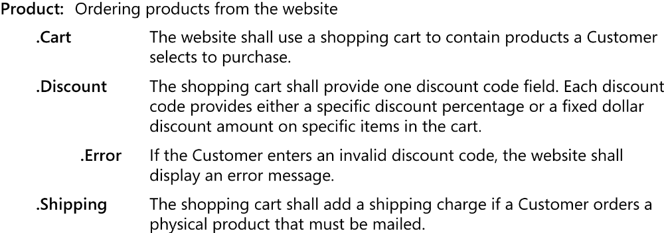
Example of Hierarchical Textual Tags

Slide 16
Labelling Requirements - Hierarchical textual tags
This hierarchical scheme avoids the maintenance problems with the hierarchical numbering, but the tags are longer and you do have to think of meaningful names for them, perhaps building from the name of the relevant feature.
It can be challenging to maintain uniqueness, especially if you have multiple people working on the set of requirements.
You can simplify the scheme by combining the hierarchical naming technique with a sequence number suffix for small sets of requirements: Product.Cart.01, Product.Cart.02, and so on. Many schemes can work.

